Slide 1

Scalable Open Source Data Science on Bare Metal Kubernetes
3/8/2024
Scott A. Williams
Linux DevOps Engineer, UC Santa Barbara
Letters & Science IT - UC Santa Barbara

Slide 2
Short Bio
DevOps Engineer at UC Santa Barbara
Fedora Ambassador
Administering containers since ~2015

Slide 3
Scope
The high level journey from public cloud to on prem bare metal Kubernetes
Tooling and workflows to support it
What we learned along the way
Not in scope:
Why any one vendor is better than another
Setting up a data center

Slide 4
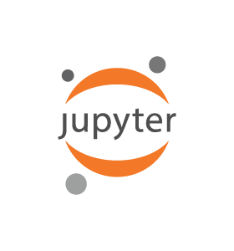
Definitions: What is Jupyter?
Free open source python execution environment:
  Jupyter Notebook
  Jupyter Lab
A way to run and debug python in an interactive way
Notebooks saved as ipynb
  Can be shared via git, etc.
Often used in data research and classrooms

Slide 5

Definitions: What is RStudio?
Rlang is a common open source data science programming language
Rstudio is a GUI IDE for doing Rlang development
Jupyter also has r-notebook

Slide 6
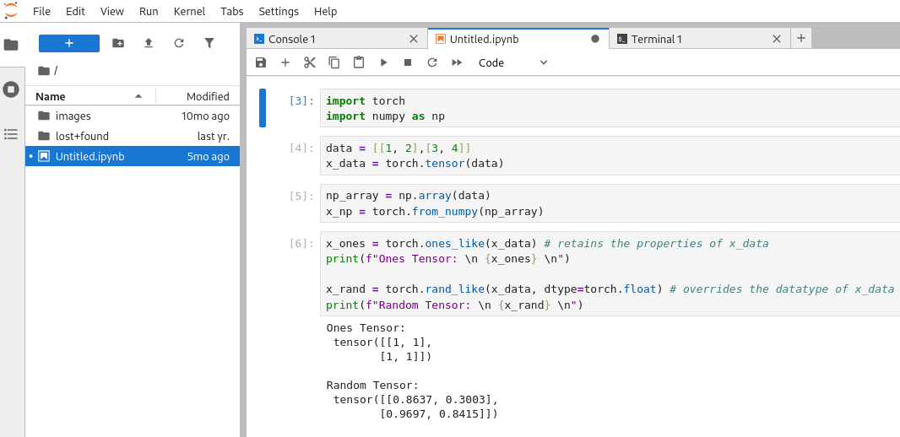
Definitions: What is JupyterHub?
A central hub entry point for provisioning and accessing Jupyter (and Rstudio) environments
Provides RBAC
Runs in Kubernetes

Slide 7

Definitions: What is Bare Metal Kubernetes?
Kubernetes is running directly on server hardware and not through a hypervisor and/or public cloud layer (eg, AWS, GCP, Azure)
Is it still “cloud native” – depends on your definition and practices

Slide 8

Cloud Native – But Local
“[Cloud Native] refers to how applications are built and delivered, rather than just where they are deployed. In some cases, an application may not even run in the cloud.”
-Google Cloud Documentation

Slide 9
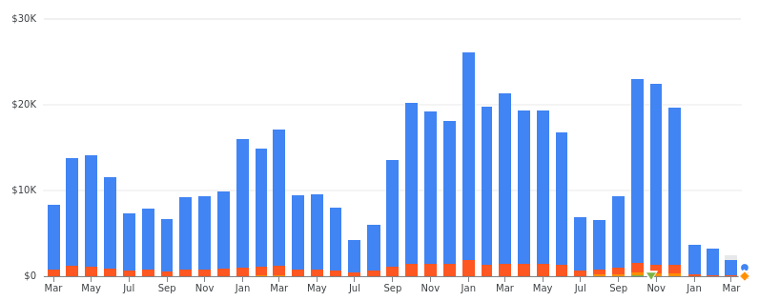
Story Time: A Tale of Two JupyterHubs
Started on Google Kubernetes Engine (GKE)
Got popular (a good problem to have!)
Costs scaled with users
Even with Cloud best practices there’s no such thing as a free lunch. With over 51 courses and 4600+ users, the projected bill for January was over $30,000.

Slide 10
How did it start?
Collaboration with Department of Statistics and Applied Probability (PSTAT)
Initially tried Docker Swarm. Needed better scale
Google Cloud:
  Zero to JupyterHub (UC Berkeley)
  Free credits
Slowly expanded to other departments via word of mouth

Slide 11
Zero to JupyterHub (z2jh)
Initially based on Google GKE, but documentation since matured
Helm based deployment
Useful things for public cloud:
  Horizontal scaling
  Bin packing
  Hot spare instances
  Culling

Slide 12
Tooling Stack
Docker Hub (public, Team-level subscription, shared)
GitHub Actions
Terraform Cloud
Git-crypt
Faculty/researchers curated own images with support from IT
Each classroom a separate Google Project, k8s cluster, DNS subdomain
Google Auth

Slide 13
Tooling Problems
Lots of manual steps for deployment
  Google project setup, billing, Oauth generation
  Terraform Cloud project setup
Git-crypt sometimes yielded unhappy surprises
Terraform frequently caused problems
  Dependencies
  Triggered accidental k8s upgrades on simple helm patch
  Fixes requiring manual intervention might cause state file validation to fail
  Broke for no good reason but then worked on retry
DNS/LetsEncrypt race to fail

Slide 14
A new era
Within a short amount of time, the devs who built the first iteration all left the organization
Initially just trying to keep the ship afloat (pun intended)
Demand continued to grow
Documentation, git, common tools gave us a fighting chance

Slide 15

Image Curation
Many images were years old
  Years of not having security patches in an internet facing service
  Some images could no longer be built
  Some images took over an hour to build on a Ryzen 7
  “Same image as last time, but I also need this one library” sometimes meant days of work

Slide 16
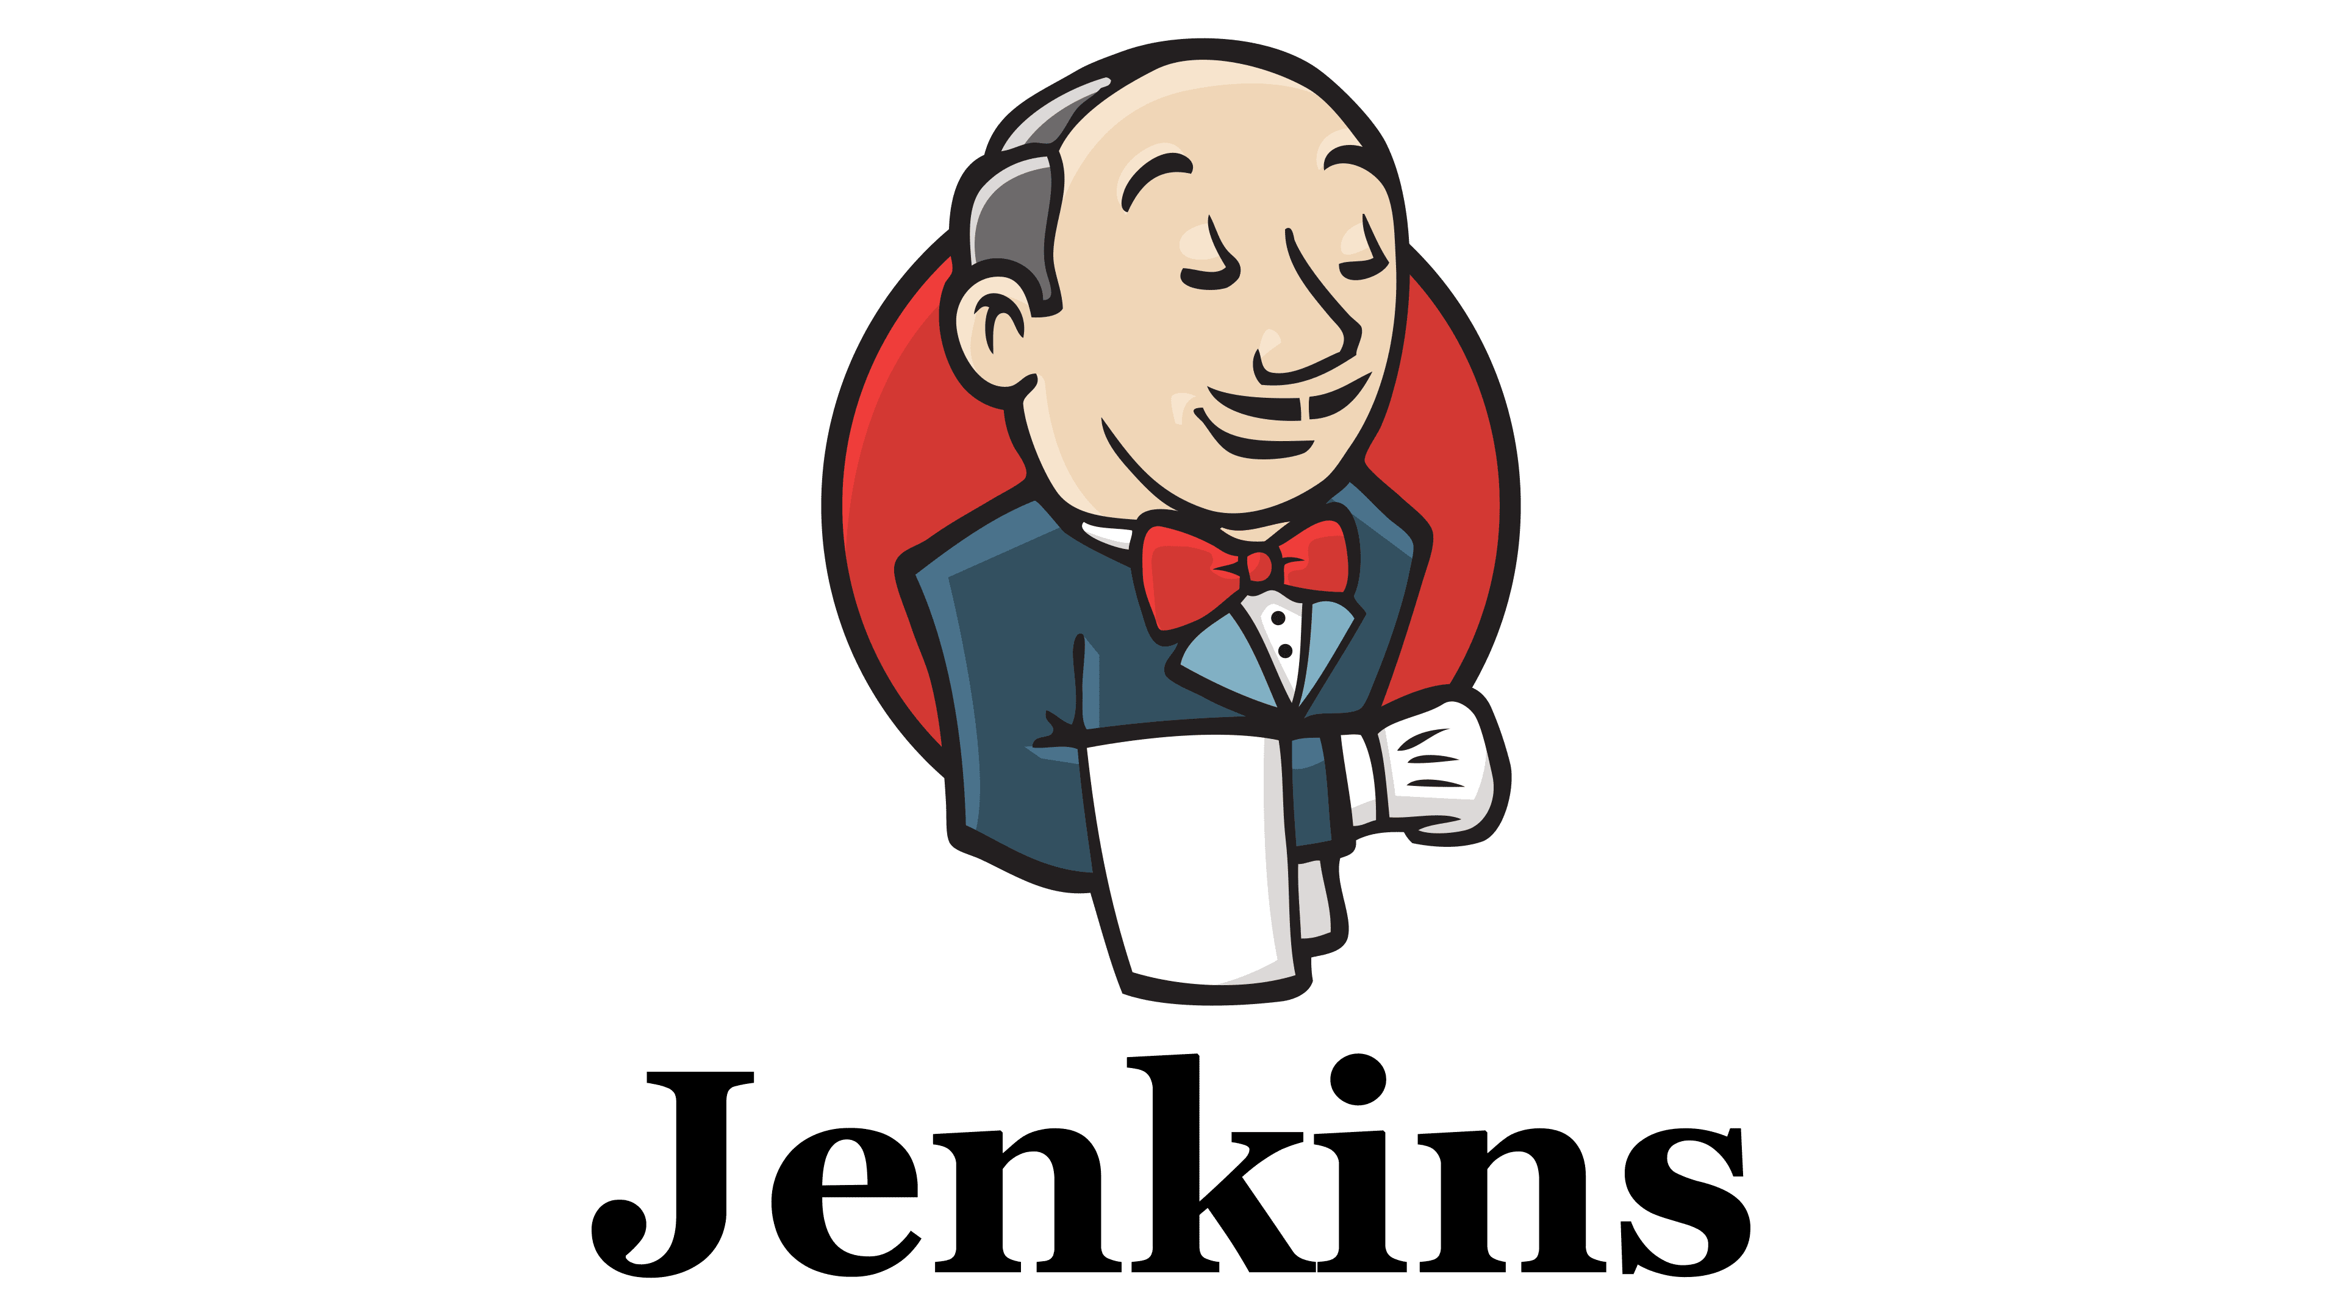
Enter Jenkins
Grouped common image needs into base images
  Initially base Jupyter and Rstudio
  Eventually added SciPy and Pytorch bases
  Aarch64 and CUDA support added
Took over image curation from faculty. Library needs were declared in form during instance request.
Course images built from base images. Base image builds trigger downstream builds
Tests added in response to issues. Images rebuilt, tested, updated at least weekly.
Open Sourced all the images – github.com/UCSB-PSTAT

Slide 17
Other improvements
Moved to closer regions to improve latency issues
  A more obvious problem once students came back from COVID-19 remote
Better instance and storage types
  N2D EPYC instead of Intel
More scripting of the deployment process
Cleanup scripting for storage beyond SLAs
Cut GCP bill in half
Hired another Kubernetes Engineer

Slide 18
Crossroads: A Good Problem To Have
With improvements, services continued to gain popularity
Costs continued to rise*
Too expensive to afford
Too important to kill
*The month we cut over to bare-metal we were projected to spend over $30k for one month of GKE/GCP

Slide 19
Path to On Prem
Migration to on-prem took about a year
Provisioned new hardware (EPYC closely matching N2D)
Re-tooled workflows
Evaluated many commercial vendors:
  Sidero Metal (TalosLinux)
  Red Hat OpenShift
  Rancher (SUSE)

Slide 20
Better Tooling and Addressing Pain Points
Logging, Monitoring, Secrets, Deployments, GitOps, Life Cycle Management in line with SLAs
Also new challenges: Installing and maintaining an operating system. Networking. Storage provider(s).
Baremetal processes are now more “cloud native” than when we were running on “public cloud”

Slide 21
Secrets Management
No More git-crypt!!!
Around the time of Hashicorp relicense
Infisical*
  Self-host in Kubernetes
  Commercial support
  Integrated with Kubernetes, Jenkins, Ansible, etc., etc.
  Built in dev, test, prod credential levels
*open core

Slide 22
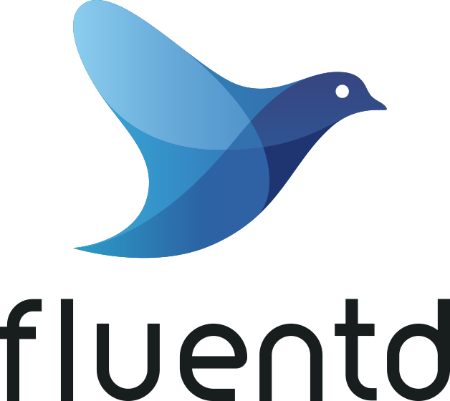

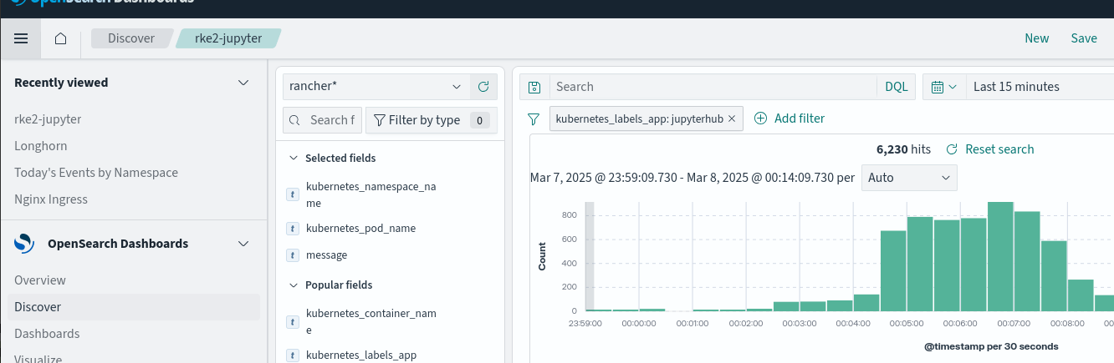
Logging

Slide 23


Monitoring
Prometheus
Grafana
AlertManager
- On GKE, our pod limits were a lie. Grafana made the problem obvious.

Slide 24

Deployments
No more Terraform
Git template repos in Forgejo
Git updates trigger Jenkins pipeline
  PR driven, Dev, Test, Production workflow
  Helm + Infisical driven
  Automatic production rollback on test failure
  Can test Jhub level changes before production deployment now
  Manual patches don’t break non-existent state files, but we also need to do them less often

Slide 25
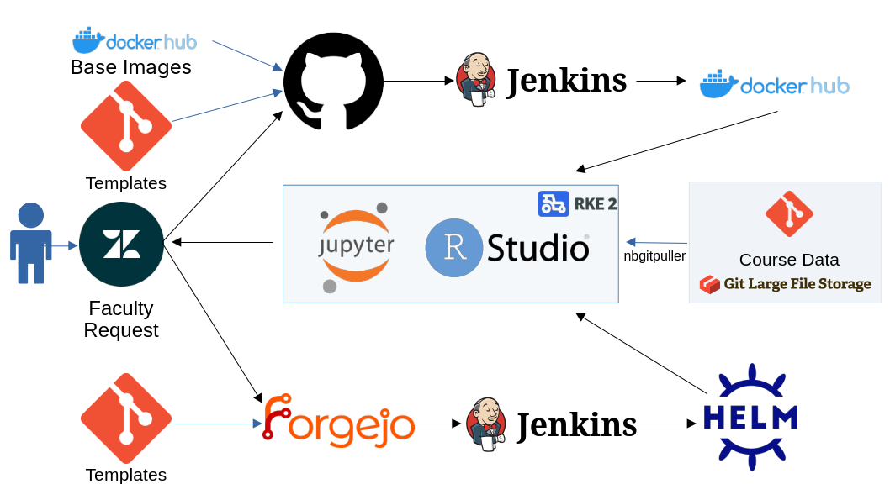

Slide 26
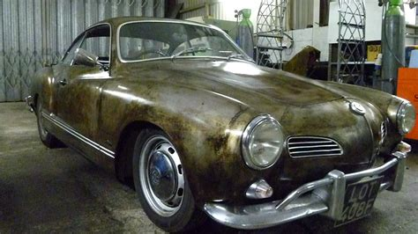
Bare-Metal Stack
Operating System
Common service automations
Networking
Storage

Slide 27
Operating System: Elemental
Immutable Linux based on SLE Micro (SUSE)
Define customizations with cloud-data (yaml)
Generates an iso to initially boot via BMC, etc
Roll out upgrades
Standby nodes that can join a cluster/role on demand
Can clean wipe and reprovision on node failure

Slide 28
Fleet
Rancher’s in house CD
Similar to ArgoCD, but still uses helm
Can automatically apply to all managed Rancher kubernetes clusters
Example: cert-manager for Let’s Encrypt for ingress

Slide 29
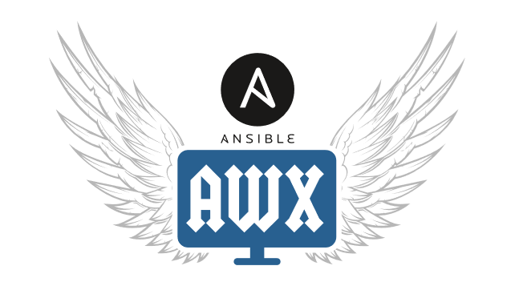
Networking
Internal DHCP NAT/VLAN (can get out, but not directly listen)
  Configs defined in git
  Ansible AWX ensures server configs match git declarations
HA Proxy + KeepAlived for Ingress front-end
  Configs defined in git
  Ansible AWX ensures server configs match git declarations
DNS
  Configs defined in git
  Ansible AWX ensures server configs match git declarations
Wireguard for encrypted backchannel

Slide 30
Storage
Longhorn
  Pods run on fast local NVMe disks
  Data replicated to at least 2 other nodes
  Uses iscsi on the backend
Ceph (External)
  Longhorn Backups
  Longterm data in RGW (S3)
  Larger k8s volumes in RBD

Slide 31
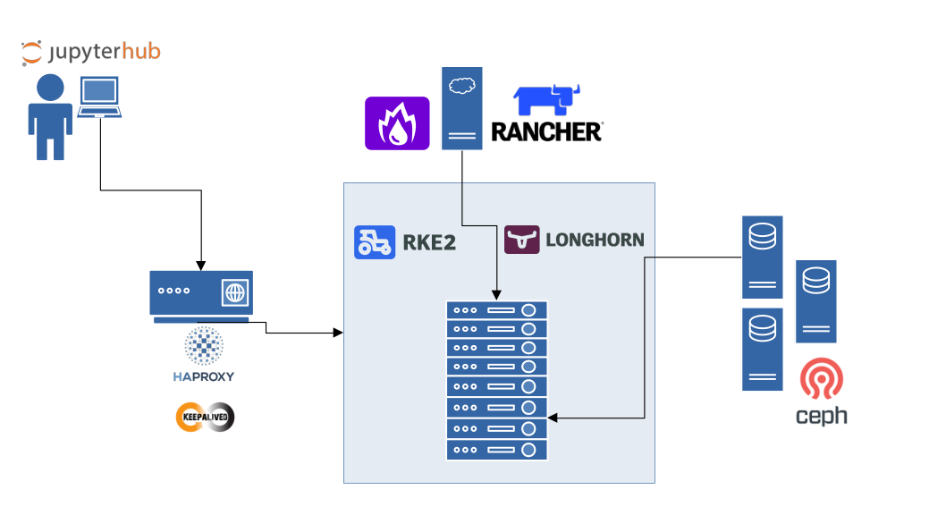

Slide 32
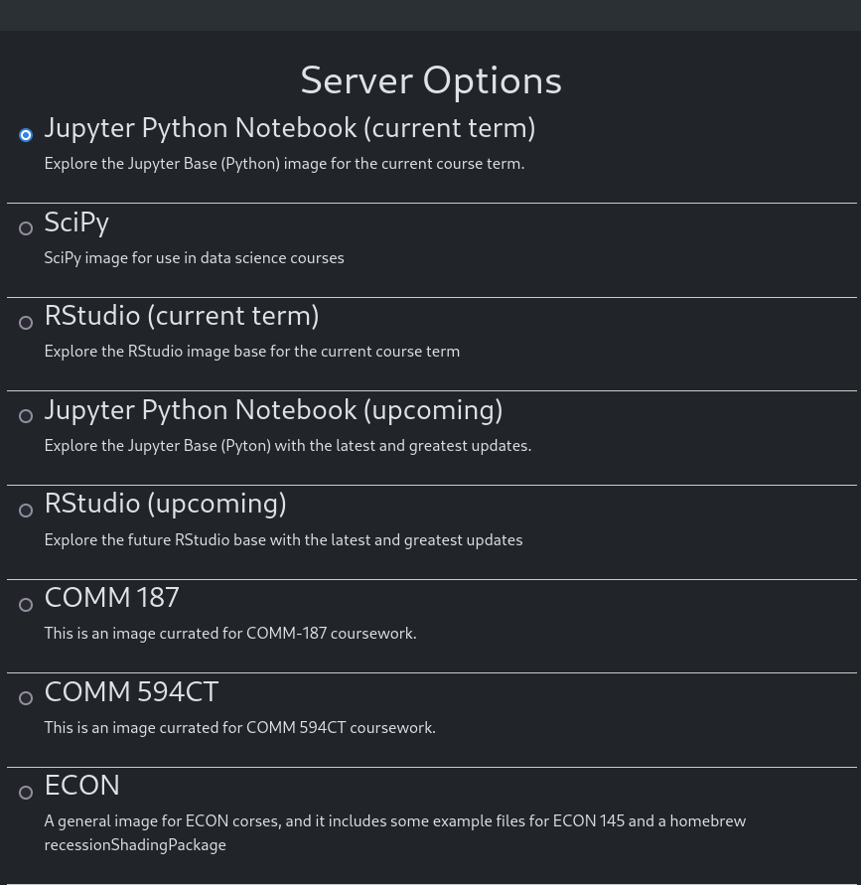
Dev, Staging, Prod
Dev, Staging, Prod for
Jupyter environments
Dev, Staging, Prod for
Rancher Environments
(Closely matching hardware
on your test and production
environments will save you
some grief, weeping, and
gnashing of teeth with bare
metal in production!)

Slide 33
Results
Initial cost to move to Bare Metal was a little under 1/3 of the projected Google spend for the same year
  Already had established data center, networking, etc.
  Not factoring electricity costs
CapX funding was a fight – on top of Google spend for one year. Funding from student fees.
Now have something far more sustainable with room for growth
Most faculty and students couldn’t tell we changed anything at all

Slide 34
Growth Opportunities
Harvester
Aarch64
GPU compute
BinderHub
Coder

Slide 35
Open Source
Nearly entire stack is fully open source and much of it with some level of paid commercial support
Regular CI image builds yield opportunities to contribute upstream with issues and PRs
Engagement and collaboration opportunities within UC and Higher Ed

Slide 36
Questions?
If a Kubernetes node falls in the cluster, but Elemental reprovisions a replacement before service alerts fire, does it still make a sound?

